Slide 1



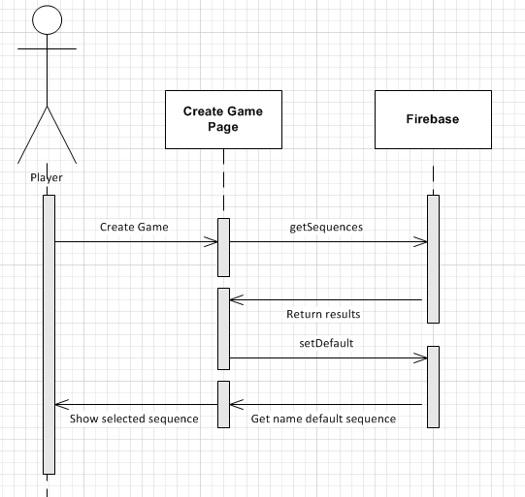


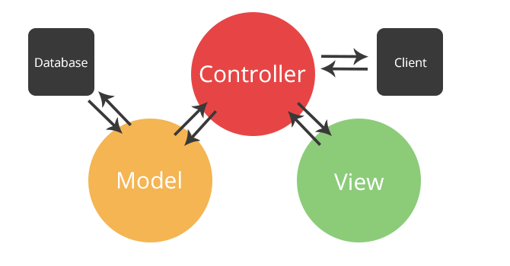

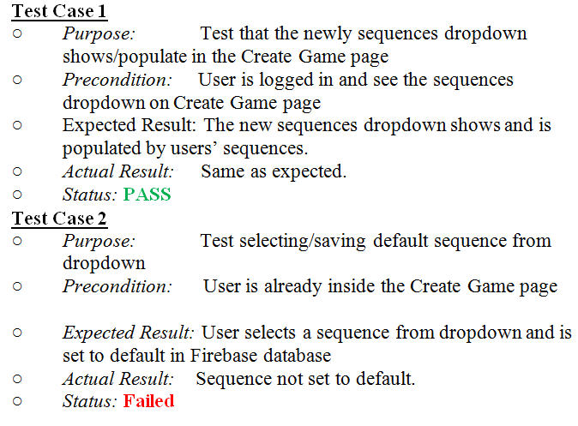
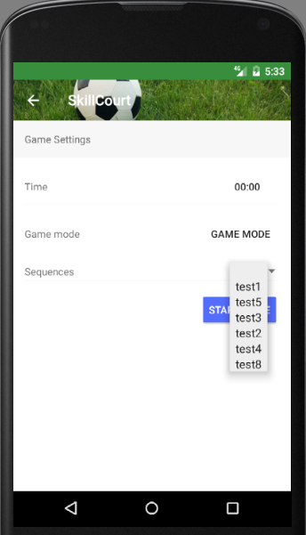
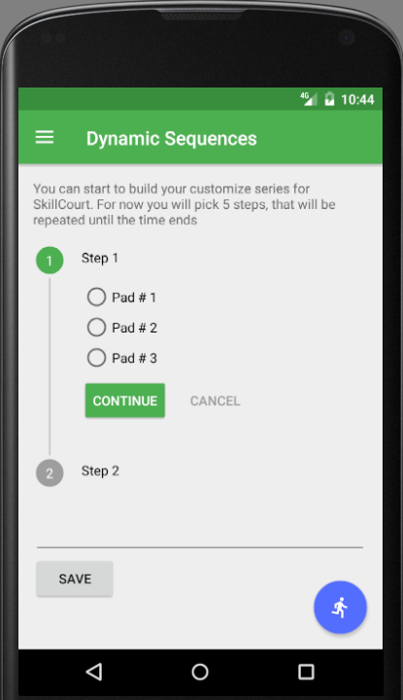
School of Computing & Information Sciences
Advanced software Engineering , 2016, Fall
Skill Court 6.0
Student: Rolando Ramos, Florida International University
Mentor: Mohsen Taheri, Gummi Traustason
Instructor: Masoud Sadjadi, Florida International University
Problem
Current System
Requirements
Improve the previous Skill Court system
Dependency of a computer to interact with the Skill Court system.
Custom pad sequences needed in order to test the player skills.
System doesn’t support Wi-Fi connectivity
Specifically I sought to improve
Create android app to interact with the system.
Feature to create custom order sequences to hit the pads.
Assign a default sequence.
Android app created to facilitate interaction with hardware.
Player can create custom sequences.
Custom sequences will be saved with a name assigned.
Last sequence used will be saved as default.
Custom Sequence page needed
User should be able to select custom order to hit the pads.
Dropdown with saved sequences will display to the user before starting game
System Design
Object Design
Implementation
SkillCourt is an android app that connects with the arduinos via Wi-Fi. It uses Firebase to store all the data. SkillCourt follows a Three-Tier Client Server and MVC architecture.
Verification
Screenshots
Summary
SkillCourt is an interactive training system that measures, challenges and improves an athletes' physical and cognitive abilities.
My major contribution to this project was to introduce the custom sequence feature. Now the player can play it with different difficulties level based on the custom sequence saved.
Acknowledgement
The material presented in this poster is based upon the work supported by Rolando Ramos I am thankful to the help that I received from my group members Pedro Carrillo, Jofran Pena and April Perry
Notes:
1

